Slide 1
RESTful Web Services
Srikanth Gunturu
Guest Faculty
BITS, WILP

Slide 2
In this segment
RESTful Web Services
REST – Architectural Constraints
JAVA API FOR RESTFUL WEB SERVICES (JAX-RS)
Annotations
Server deployment
Client API
JSON API

Slide 3
RESTful Web Services
REST – Architectural Constraints
Client-server model - “Servers and clients may also be replaced and developed independently, as long as the interface between them is not altered”
Statelessness - “No client context shall be stored on the server between requests. Client is responsible for managing the state of application.”
Cacheability – “Well-managed caching partially or completely eliminates some client–server interactions, further improving scalability and performance”
Layered system – “Client need not be aware of underlying layers managed by the service provider”
Code-on-demand (optional) – “..when you need to, you are free to return executable code to support a part of your application..”
Uniform interface – “Once a developer become familiar with one of your API, he should be able to follow similar approach for other APIs”
Resource identification in requests
Resource manipulation through representations
Self-descriptive messages
Hypermedia As The Engine Of Application State (HATEOAS)

Slide 4
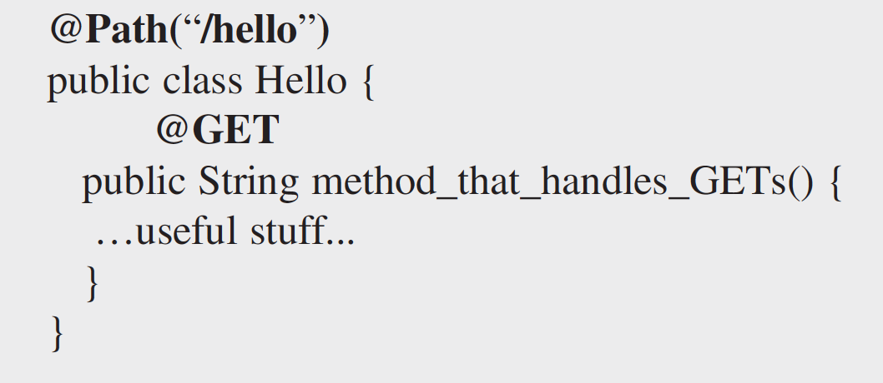
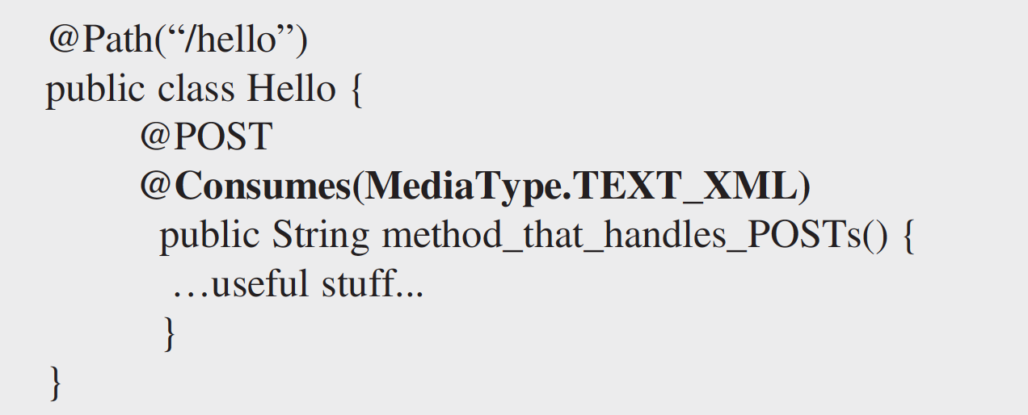
RESTful Web Services
JAVA API FOR RESTFUL WEB SERVICES (JAX-RS)
Java based middleware for creating RESTful web services
Reference Implementations – Jersey, Apache CXF, Spring
Commonly deployed on a servlet container, or EJB / OSGi container
Method Annotations
@GET
@POST
@PUT
@DELETE
MIME Annotations
@Consumes
@Produces
Parameter Annotations
@PathParam
@QueryParam
@FormParam

Slide 5
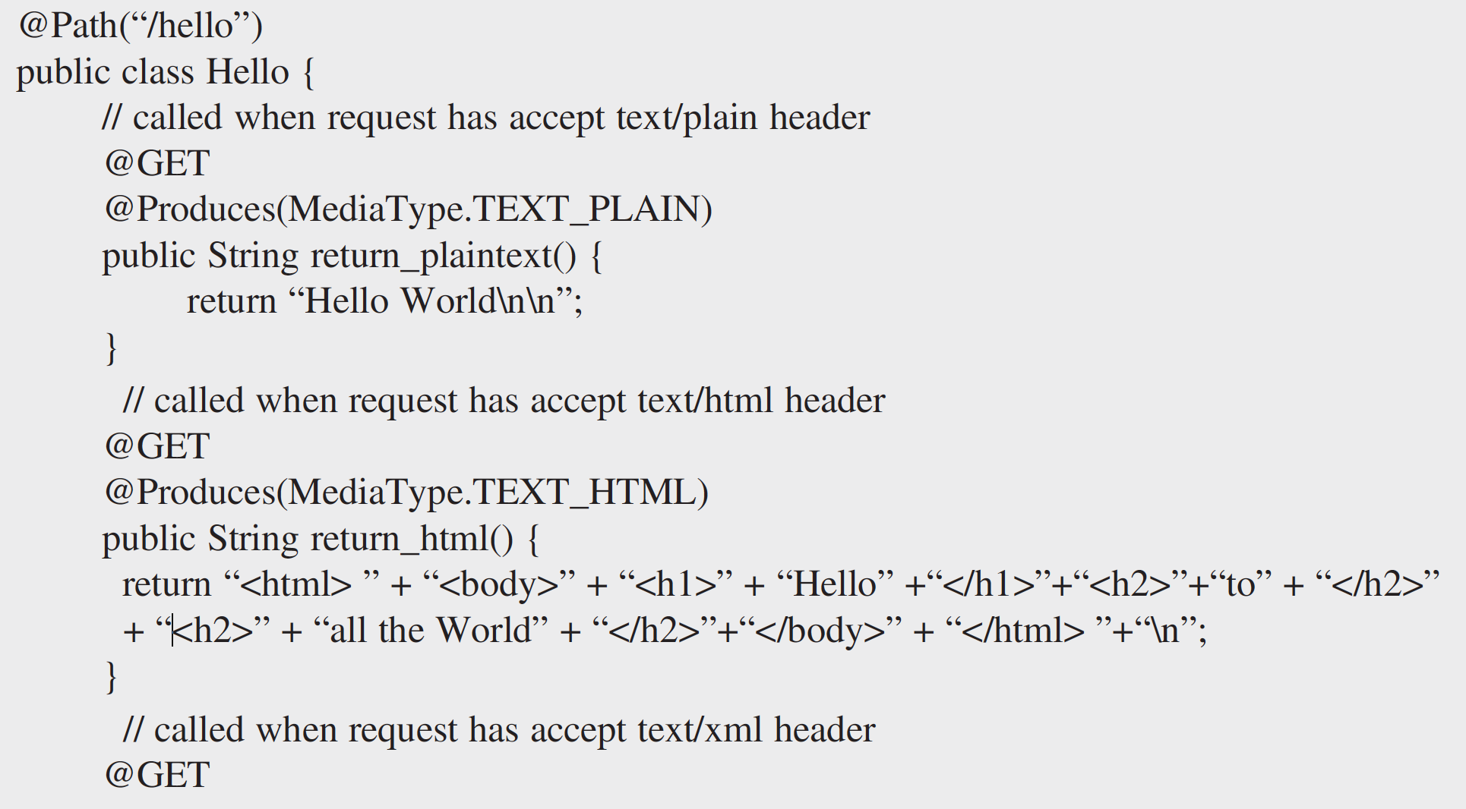
RESTful Web Services
JAX-RS – Sample code

Slide 6
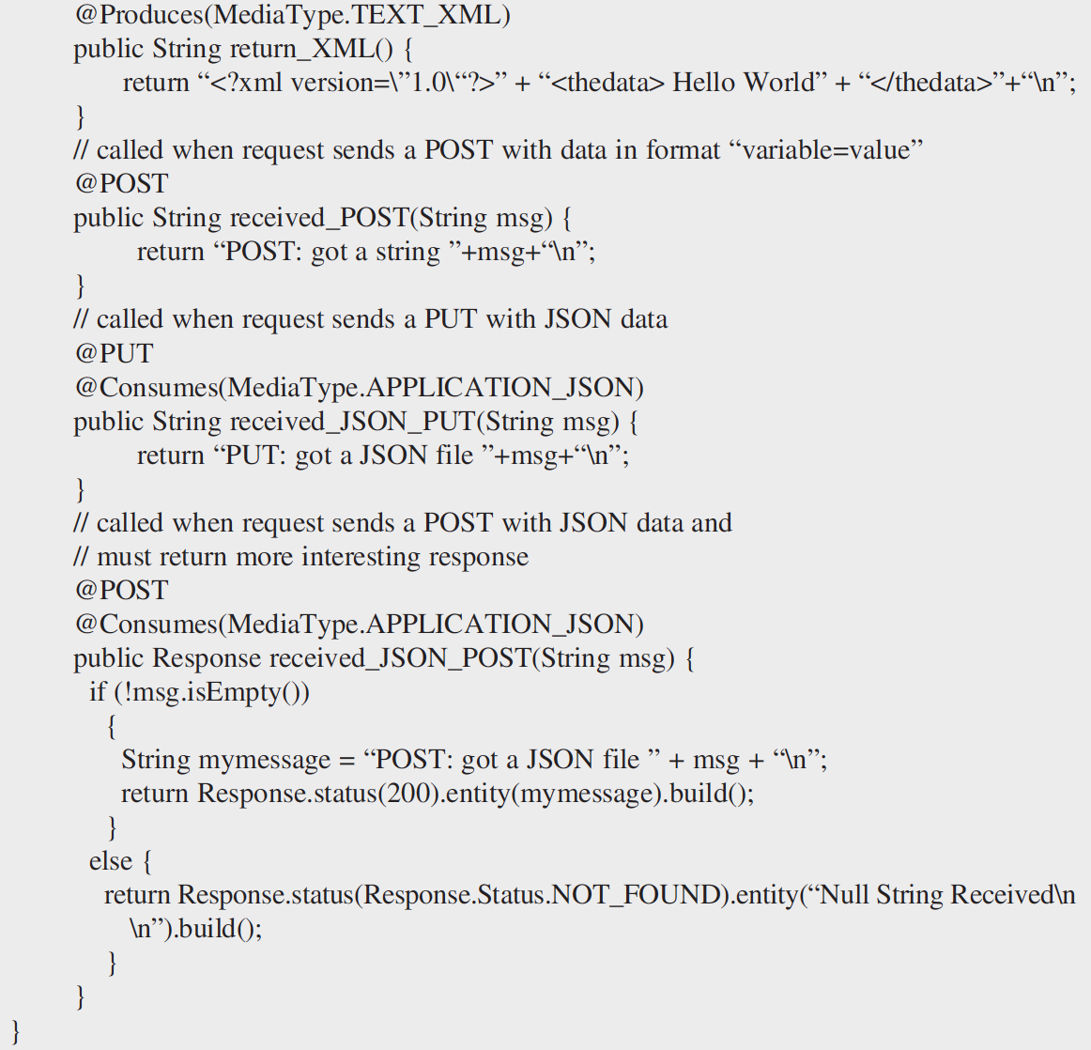
RESTful Web Services
JAX-RS – Sample code

Slide 7
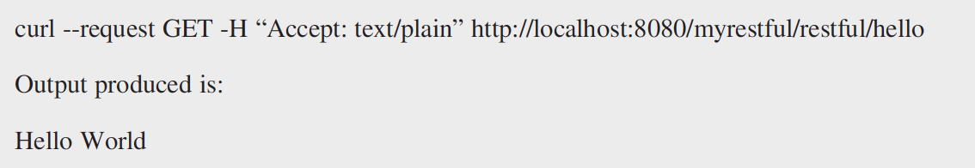
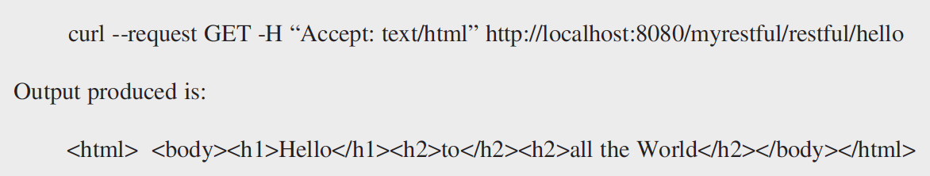
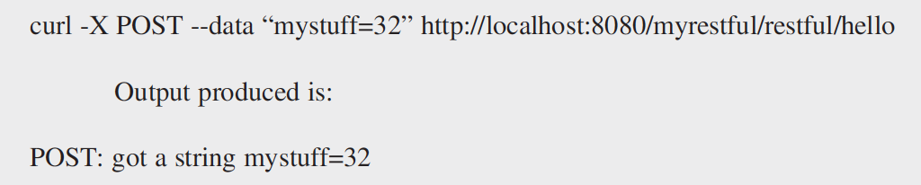
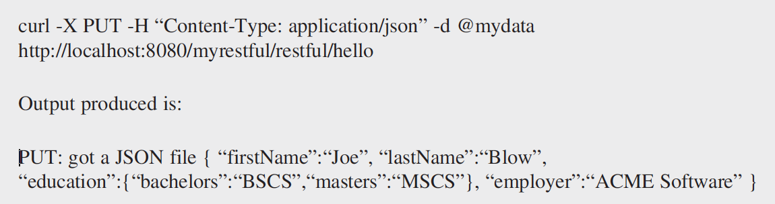
RESTful Web Services
JAX-RS – Sample code execution
GET
Media type - text/plain
Media type - text/html
POST
PUT

Slide 8
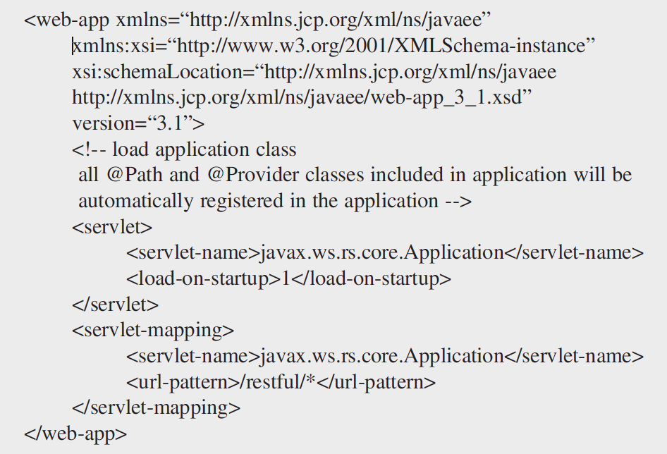
RESTful Web Services
Deploying JAX-RS server
Using Deployment Descriptor

Slide 9
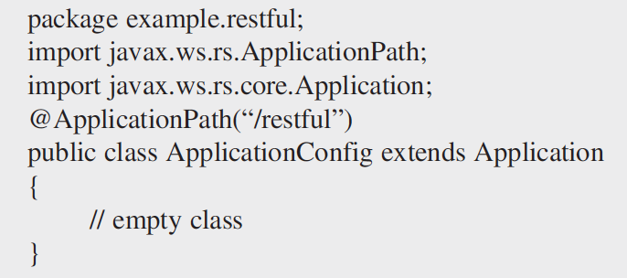
RESTful Web Services
Deploying JAX-RS server
Using ApplicationConfig class

Slide 10
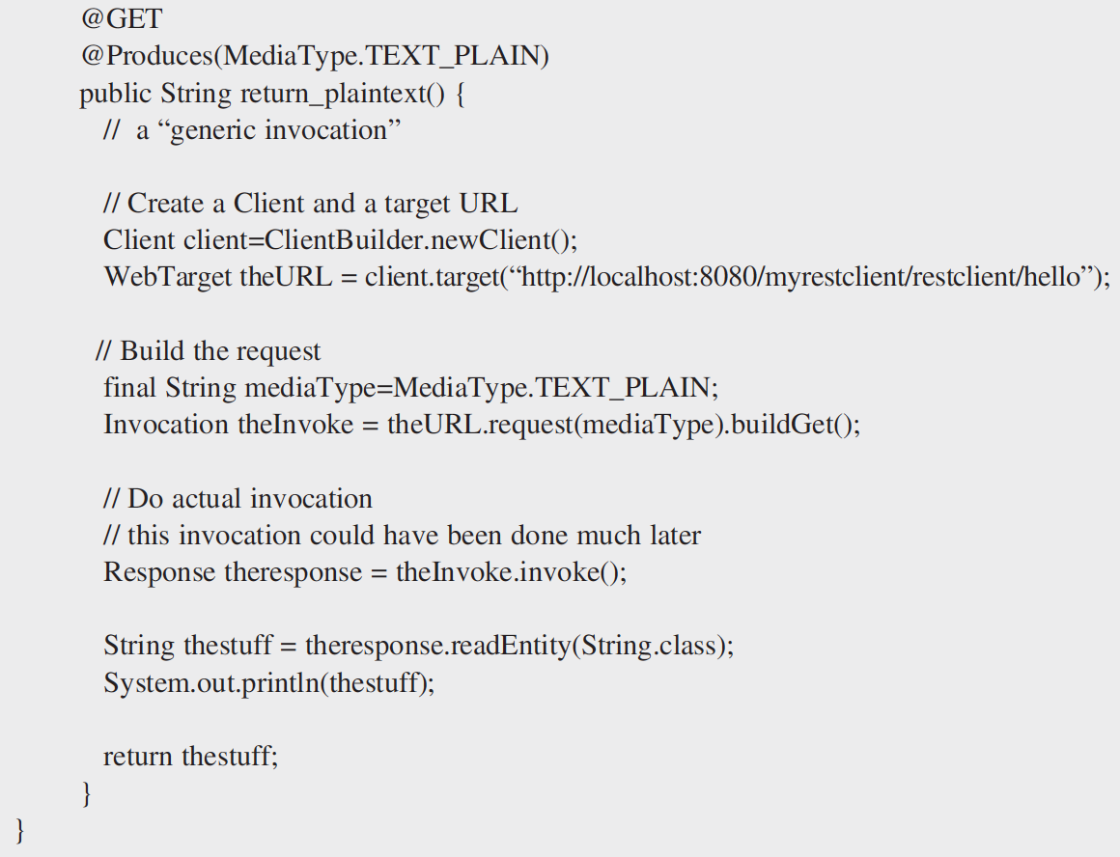
RESTful Web Services
JAX-RS Client API
Using Generic Invocation

Slide 11
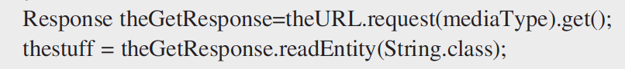
RESTful Web Services
JAX-RS Client API
Using Specific Invocation

Slide 12
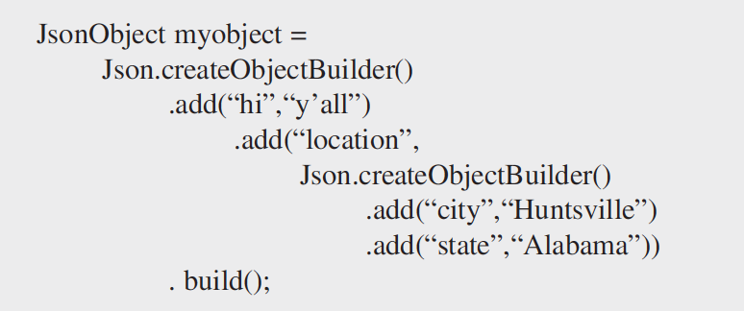
RESTful Web Services
JAX-RS JSON API
Building a nested JSON object

Slide 13
Thank You!
In our next session:
Middleware for Cloud applications

